Slide 1
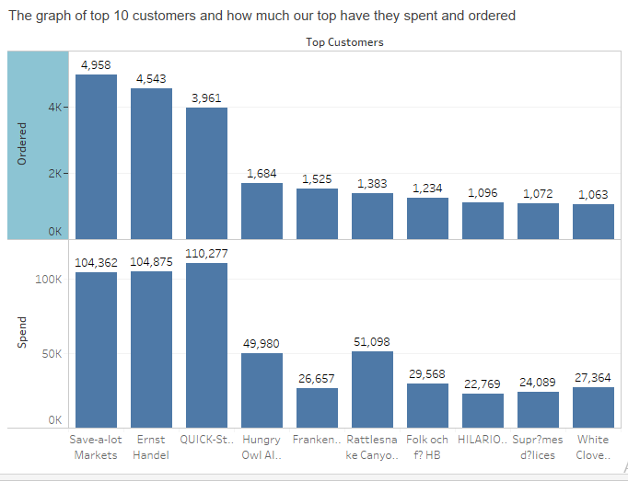
The graph above displays our Top 10 Customers and how much they have spent and ordered. Metrics was based on the total number of quantity ordered by each customers. This is because different products have different prices and profit made is independent on the cost of the product. More so, customers buy products based on their need.

Slide 2
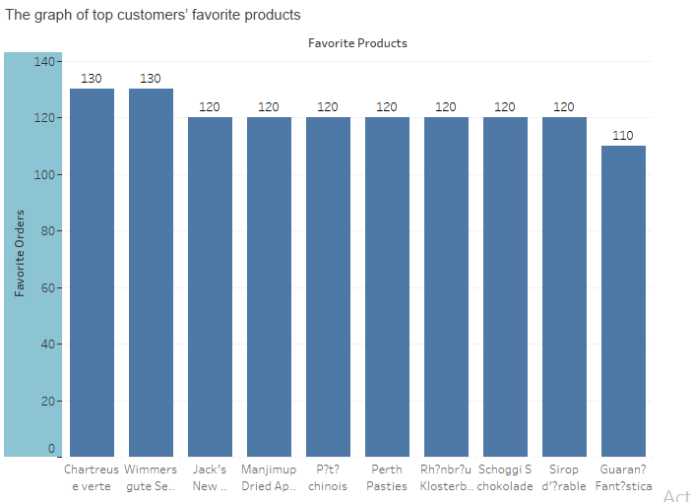
The graph above explains the relationship between our top customers and their favorite products.
The favorite products was based on the sum of quantity ordered by each customers on different products.

Slide 3
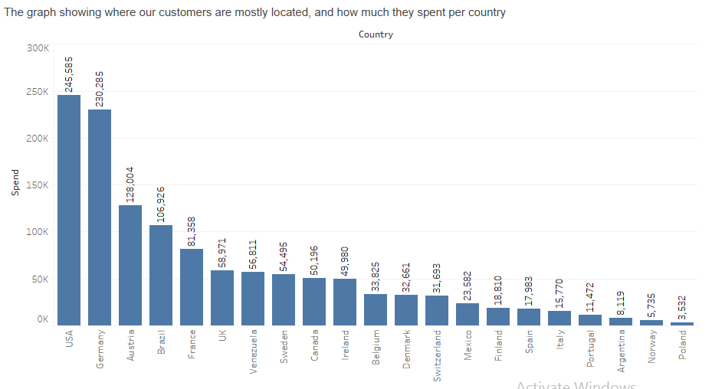
The graph above shows countries where our customers are mostly located and how much they have spent per country.
Spend was based on unit price, quantity and discount gotten from each product.

Slide 4
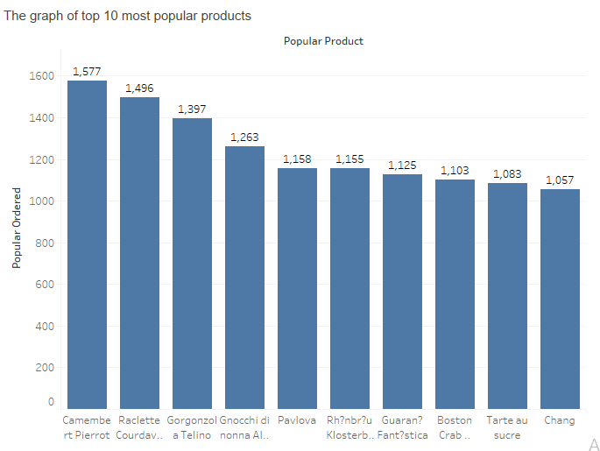
The graph above displays our popular products.
Metric used was the sum of quantity demanded on each product.

Slide 5
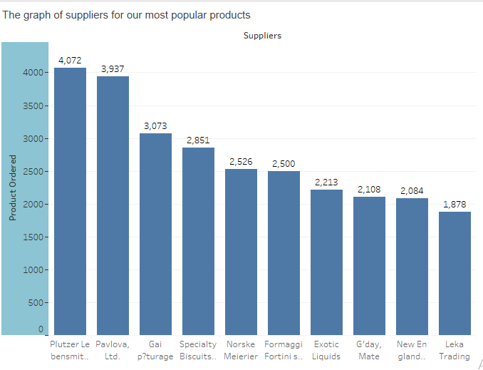
The graph above shows the suppliers of the most popular product demanded by our customers.

Slide 6
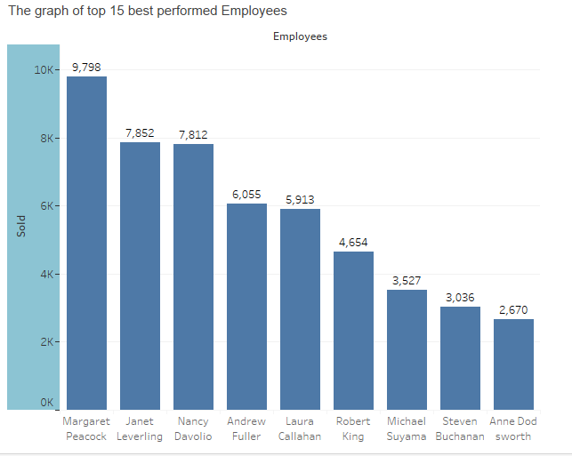
The graph above displays our best performed Employees
Metric used was the sum of quantity sold by each employee.

